Slide 1


Service Oriented Architecture (SOA)
Presenters:
Rupak Gadtaula
Abik Pokhrel
Aneesh Nepal
Anu Bogati
Bipin Quinkel
Rachana Dahal
Cloud computing

Slide 2
SOA-Introduction
It is a type of software design that makes software components reusable using service interfaces that use a common communication language over a network.
SOA is an architectural approach in which applications make use of services available in the network.
Example :
Google Docs
Service
The service is a kind of operation which is well defined, self contained that provides separate functionality such as checking customer account details, printing bank statements etc. and does not depend on the state of other services.
Services are provided to form application through internet.
Services are self-contained (perform predetermined tasks) and loosely coupled (for independence).
Services can be dynamically discovered.
Cloud computing

Slide 3
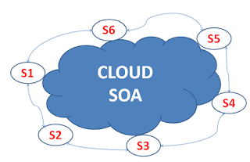
Services within the cloud
Cloud computing

Slide 4
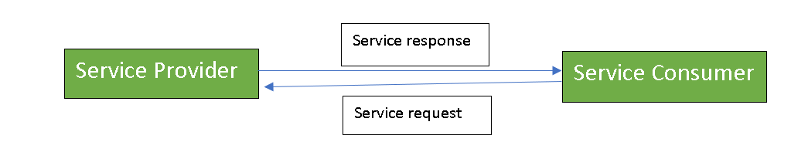
There are two major roles within Service-oriented Architecture:
Service provider:
The service provider is the maintainer of the service and the organization that makes available one or more services for others to use. To advertise services, the provider can publish them in a registry, together with a service contract that specifies the nature of the service, how to use it, the requirements for the service, and the fees charged.
Service consumer:
The service consumer can locate the service metadata in the registry and develop the required client components to bind and use the service.
Cloud computing

Slide 5
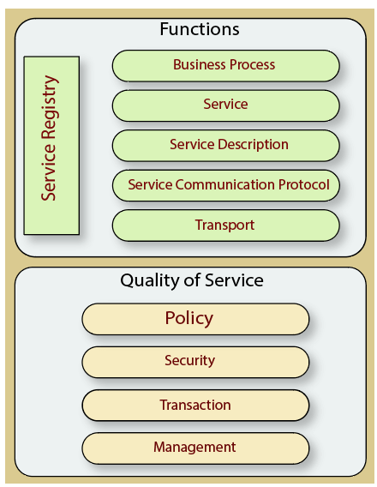
Components of SOA
The service-oriented architecture stack can be categorized into two parts - functional aspects and quality of service aspects.
Cloud computing

Slide 6
Functional aspects
The functional aspect contains:
Transport - It transports the service requests from the service consumer to the service provider and service responses from the service provider to the service consumer.
Service Communication Protocol - It allows the service provider and the service consumer to communicate with each other.
Service Description - It describes the service and data required to invoke it.
Service - It is an actual service.
Business Process - It represents the group of services called in a particular sequence associated with the particular rules to meet the business requirements.
Service Registry - It contains the description of data which is used by service providers to publish their services.
Cloud computing

Slide 7
Quality of Service aspects
The quality of service aspects contains:
Policy - It represents the set of protocols according to which a service provider make and provide the services to consumers.
Security - It represents the set of protocols required for identification and authorization.
Transaction - It provides the surety of consistent result. This means, if we use the group of services to complete a business function, either all must complete or none of the complete.
Management - It defines the set of attributes used to manage the services.
Cloud computing

Slide 8
Service-Oriented Architecture (SOA) Principles:
Standardized Service Contract
Loose Coupling
Service Abstraction
Service Reusability
Service Autonomy
Service Statelessness
Service Discoverability
Service Composability
Service Interoperability
Cloud computing

Slide 9
1. Standardized Service Contract
Services adhere to a service description. A service must have some sort of description which describes what the service is about. This makes it easier for client applications to understand what the service does.
2. Loose Coupling
Less dependency on each other. This is one of the main characteristics of web services which just states that there should be as less dependency as possible between the web services and the client invoking the web service. So if the service functionality changes at any point in time, it should not break the client application or stop it from working.
3. Service Abstraction
Services hide the logic they encapsulate from the outside world. The service should not expose how it executes its functionality; it should just tell the client application on what it does and not on how it does it.
Cloud computing

Slide 10
4. Service Reusability
Logic is divided into services with the intent of maximizing reuse. In any development company re-usability is a big topic because obviously one wouldn’t want to spend time and effort building the same code again and again across multiple applications which require them. Hence, once the code for a web service is written it should have the ability work with various application types.
5. Service Autonomy
Services should have control over the logic they encapsulate. The service knows everything on what functionality it offers and hence should also have complete control over the code it contains.
6. Service Statelessness
Ideally, services should be stateless. This means that services should not withhold information from one state to the other. This would need to be done from either the client application. An example can be an order placed on a shopping site. Now you can have a web service which gives you the price of a particular item. But if the items are added to a shopping cart and the web page navigates to the page where you do the payment, the responsibility of the price of the item to be transferred to the payment page should not be done by the web service. Instead, it needs to be done by the web application.
Cloud computing

Slide 11
7. Service Discoverability
Services can be discovered (usually in a service registry). We have already seen this in the concept of the UDDI, which performs a registry which can hold information about the web service.
8. Service Composability
Services break big problems into little problems. One should never embed all functionality of an application into one single service but instead, break the service down into modules each with a separate business functionality.
9. Service Interoperability
Services should use standards that allow diverse subscribers to use the service. In web services, standards as XML and communication over HTTP is used to ensure it conforms to this principle.
Cloud computing

Slide 12
Cloud and SOA-Combination
SOA binds how you will both deliver and leverage cloud based services. Cloud computing relies on service- orientation to loosely-couple applications to underlying infrastructure model for using web services
It uses web services to compose complex, customizable, distributed applications and encapsulate legacy systems
Cloud computing

Slide 13
What does SOA provide for easily transitioning into a cloud computing environment?
One of the common misconceptions of IT and businesses is that SOA and cloud computing are simply the same and each one can replace the other. However, a more detailed look into the two systems reveals that they are actually complementary. Each supplies unique capability and functionality, and the two work together to provide an enterprise agility solution.
SOA is an architectural approach that creates services that are then shared and reused among the system itself. On the other hand, cloud computing is about creating an environment where ease of access to and usage of services is the main goal.
Cloud computing

Slide 14
Characteristics of SOA
SOA is at the core of the service- oriented computing platform.
SOA increases quality of service.
SOA is fundamentally autonomous.
SOA is based on open standards.
SOA supports vendor diversity.
SOA fosters intrinsic interoperability.
SOA promotes discovery.
SOA promotes federation.
SOA promotes architectural composability.
Cloud computing

Slide 15
Some of the points are explained.
1. SOA is at the core of the service-oriented computing platform.
An application computing platform consisting of Web services technology and service-orientation principles.
Represents an architecture that promotes service- orientation through the use of Web services.
2. SOA increases quality of service
There is a need to bring SOA to a point where it can implement enterprise-level functionality as safely and reliably as the more established distributed architectures already do.
Cloud computing

Slide 16
3. SOA is based on open standards
Significant characteristic of Web services is the fact that data exchange is governed by open standards.
After a message is sent from one Web service to another it travels via a set of protocols that is globally standardized and accepted. i.e. the message itself is standardized, both in format and in how it represents its payload.
Cloud computing

Slide 17
Role Of Standard in SOA
SOA are highly dependent of the standard and contact because of the following benefits:
It uses Standard across the whole system and partners.
Standard guarantee of Quality of Service (QoS).
It uses standard for better management and Visibility of IT assets.
By using Standard With the help of flexibility by reducing dependencies on a specific implementation.
Cloud computing

Slide 18
SOA Life cycles
The lifecycle of an SOA delivery project is simply comprised of a series of steps that need to be completed to construct the services for a given service-oriented solution.
Development projects for service-oriented solutions are, on the surface, much like other custom development projects for distributed applications
Cloud computing

Slide 19
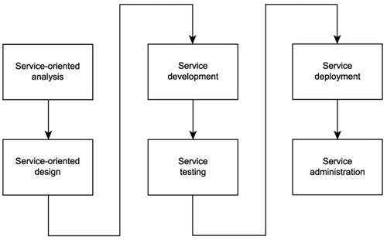
Life Cycle of SOA
Cloud computing

Slide 20
Service Oriented Analysis : It is in this initial stage that we determine the potential scope of our SOA. A formal step-by-step service modeling process is provided as dedicated to the service-oriented analysis phase. Service Oriented Design : Service-oriented design is a heavily standards-driven phase that incorporates industry conventions and service-orientation principles into the service design process the service layers designed during this stage can include which results in a formal business process definition.
Cloud computing

Slide 21
Service Development: Here development platform-specific issues come into play, regardless of service type specifically, the choice of programming language and development environment will determine the physical form services. Service testing: Cloud testing, in which cloud services used by the company are tested, such as software as a service. Performance testing, in which the product performance is tested. Service Deployment: A service deployment is a configuration of a collection of SAS Foundation Services that specifies the data necessary to instantiate the services, as well as dependencies upon other services.
Cloud computing

Slide 22
Service Administration: A service administrator is responsible for overseeing all aspects of the work order for a service department. Your job duties include coordinating with the service manager on the completion of customer work orders, putting together billing for work completed, and reviewing time cards for service employees.
Cloud computing

Slide 23
Benefits of SOA
Reliability - Using a small, independent service for SOA makes it easier to test and debug your application instead of debugging a large number of code blocks, making your service-oriented architecture very reliable.
Scalability - SOA allows services to run on multiple platforms, programming languages, and services, allowing service-oriented architecture services to run on different servers in the environment for greater scalability.
Reusability - SOA-based applications are developed by aggregating small, self-contained, loosely coupled services. This allows you to reuse a service individually in multiple applications without interacting with other services.
Agility - The capability of gathering applications from reusable components or services rather than rewriting and reintegrating new development project helps developers design an application rapidly in response to the new business requirements which in return increases the agility of SOA.
Cloud computing

Slide 24
Benefits of SOA
Location independence - Services are located through the service registry and accessible through Uniform Resource Locators (URLs), so they change location over time without disrupting the system user experience while the SOA location is independent.
Platform independence – Service Oriented Architecture enables the development of complex applications by integrating different services selected from different sources, making them platform-independent.
Loosely coupled - The concept of loose reduces the joins between classes in order to evaluate an environment where classes can be modified without breaking existing relationships.
Easy maintenance - Service-oriented architecture is an independent unit or entity, which makes it much easier to maintain or update your application without having to worry about other services.
Cloud computing

Slide 25
Is SOA always a better solution?
More than 90% of the worlds enterprise applications are monolithic though it was the best approach available. However as businesses seek greater agility developers are leaving monolithic architecture behind.
The SOA approach is ideal for complex enterprise systems such as banks. Dividing the banking system into microservices is very difficult. However, the monolithic approach is also not suitable for banking systems, as one piece can adversely affect the entire app. The best solution is to use the SOA approach to organize complex apps into separate, independent services.
Microservices are great, but they aren't suitable for all types of apps. This pattern is ideal for evolving applications and complex systems. Microservices are useful when your application is large and requires flexibility and scalability.
The serverless software architecture is advantageous for handling one-off tasks and auxiliary processes. Ideal for client-intensive apps or apps that grow rapidly and require unlimited scaling.
Cloud computing

Slide 26
Using microservice architectures helps realize the original promise of SOAs, delivering the benefits of SOAs while removing many disadvantages.
The SOA integration step should not include business logic. Attempting to enforce business logic on this approach results in workarounds and extra effort to achieve non-ideal results. The decisive factor is how to integrate microservices without side effects. Fortunately, microservices architectures can be forged from SOA by these principles.
Context mapping - when replacing an SOA, teams must consider the size and scope of the new micro service and apply proper contextual boundaries.
Shared-nothing architecture - Too many SOA integrations create sprawling dependencies that create complexity in the tech stack. Microservices avoid these cross-service dependencies. For those looking to move to microservices from an existing SOA, it’s important to look at the list of dependencies and work toward standalone functionality.
Cloud computing

Slide 27
Advantages of SOA:
Service reusability
Easy maintenance
Platform independent
Availability
Reliability
Cloud computing

Slide 28
Disadvantages of SOA:
High overhead
High investment
Complex service management
Cloud computing

Slide 29
Thank you

